Slide 1

Current Topic:
Brain to Brain Communication
By
Scott Fischer, Logan Gleeson, Ronan Shaffer

Slide 2
Topic:
A group of scientists created a way to send a string of binary from one brain into another
The string of binary was sent from one man in India to another 3 men in France

Slide 3
How?
The BCI sends the message to the CBI via the internet
The BCI takes information from the brain and translates it into binary
Once in binary it is sent to the CBI which take the message and inserts the message into the brain

Slide 4
How?
The CBI uses the binary to induce weak electrical signals in the brain using TMS
The TMS uses rapidly changing electro magnetic fields to induce the electrical currents
The electrical charges stimulate a part of the brain which induces phosphenes (light flashes)

Slide 5
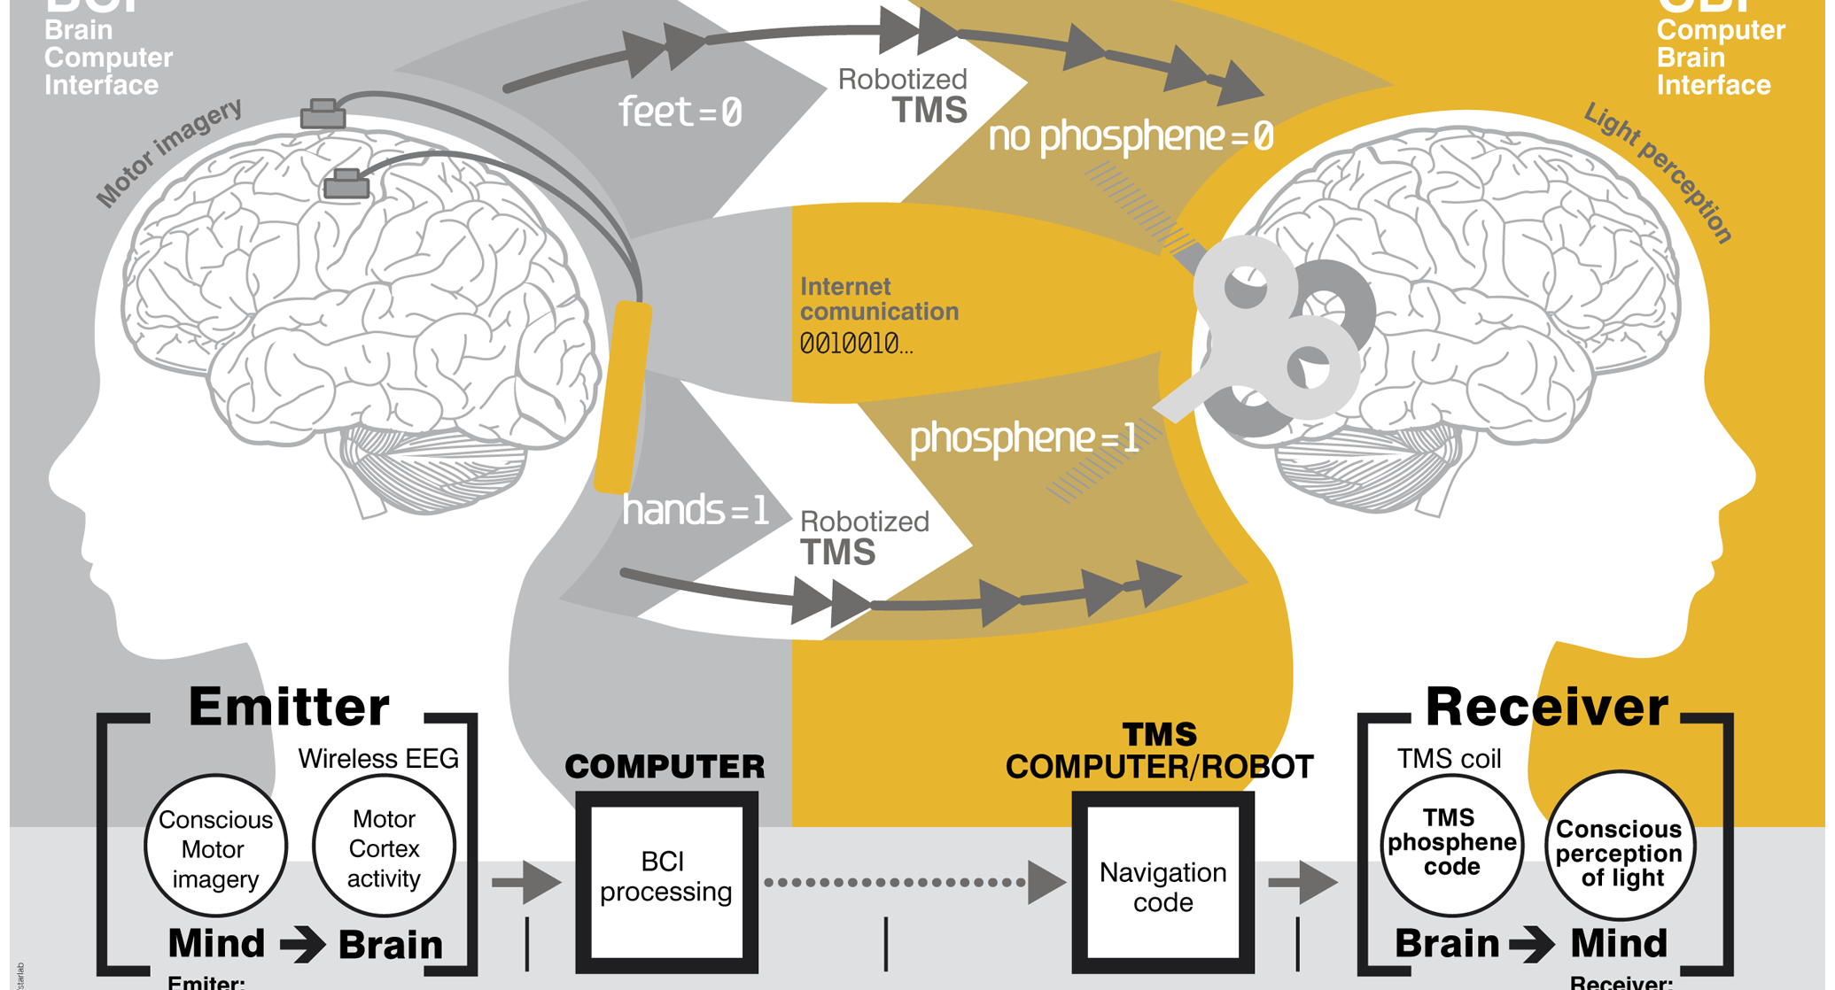

Slide 6
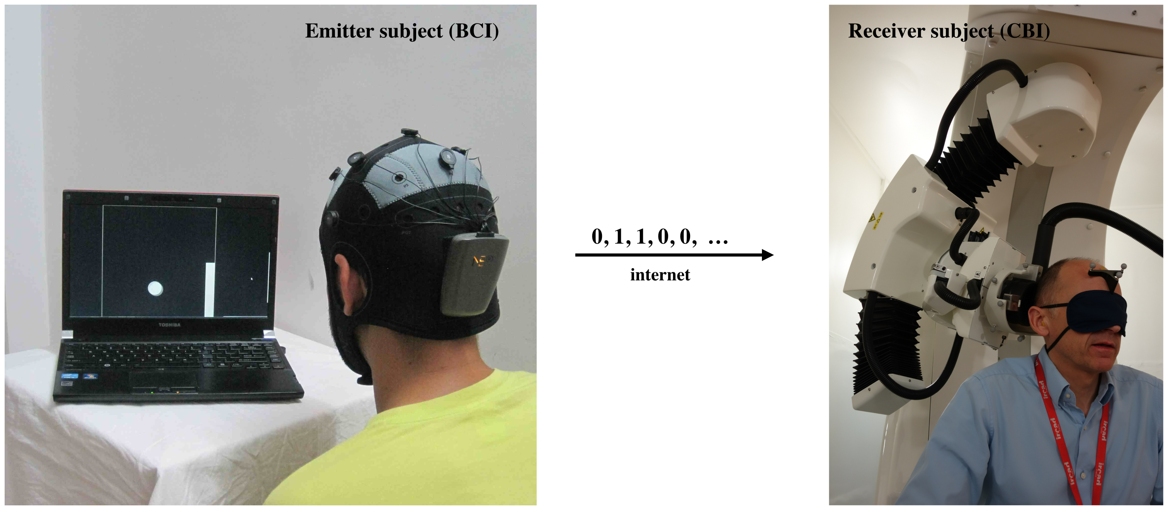

Slide 7
Importance:
Not practical now, but technology will advance in future
Provides proof of brain to brain communication possibilities
With advancement in technology it could become portable, more efficient, and more direct

Slide 8
Importance/Ethics:
Ethics will play a role in the development of this technology
Some believe that brain to brain communication is unnatural and therefore wrong
With enough advancement it could be possible to transfer information from the internet into the brain

Slide 9
Future Applications
Could be used for mutes or injured people that are unable to speak
Could create a system where you can communicate with others through just thoughts
With future advancement could be able to input information from a database into the brain

Slide 10
Interests:
The potential for this method of communication
The ethics of advancement in this field of research
The change in culture and social interaction with advancement in the technology

Slide 11
Our Questions:
Which parts of the brains can be stimulated and what effects would it have?
Is this mentally taxing to be the receiver of the message?
Could this be used for inserting information from a database into your brain?

Slide 12
Sources:
http://www.plosone.org/article/info%3Adoi%2F10.1371%2Fjournal.pone.0105225
http://www.iflscience.com/brain/direct-brain-brain-communication-used-humans
http://www.popsci.com/category/tags/brain?page=6

